Slide 1
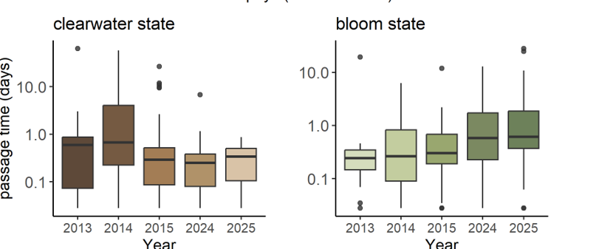

Slide 2
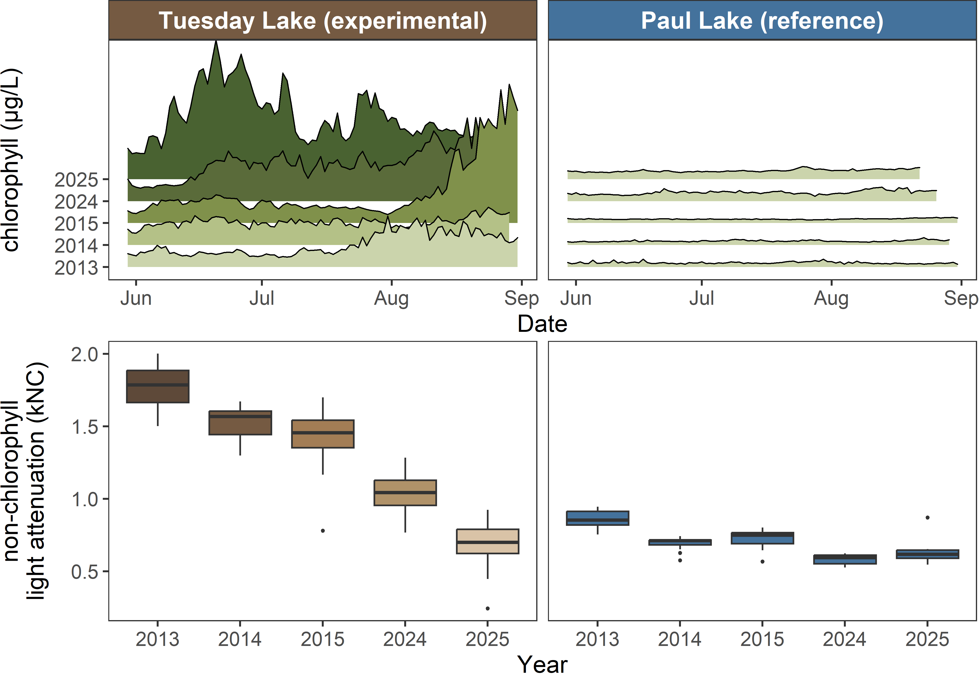
70 μg/L
70 μg/L
42 μg/L
6 μg/L
19 μg/L
7 μg/L
3 μg/L
26 μg/L
4 μg/L
4 μg/L

Slide 3
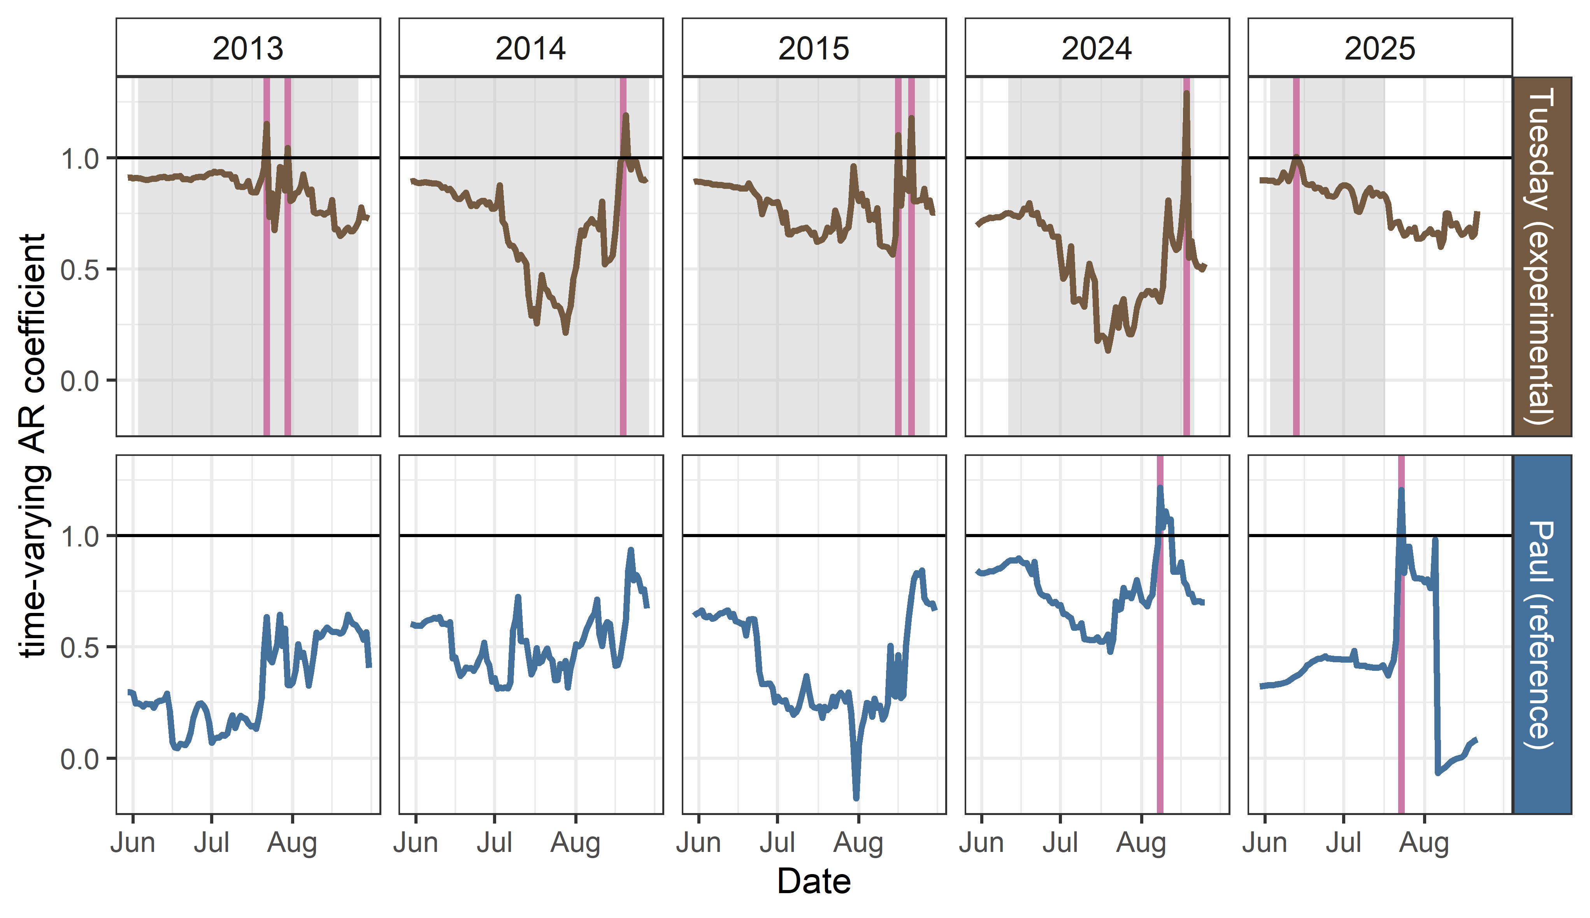
R = 0.91
R = 0.88
R = 0.85
R = 0.63
R = 0.89
R = 0.35
R = 0.57
R = 0.68
R = 0.84
R = 0.29

